Slide 1
Photo Album
by Pankaj Prabhat

Slide 2
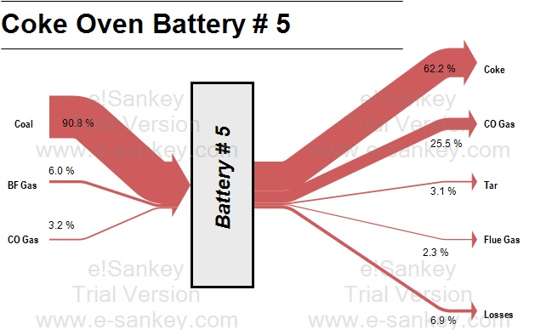
Battery # 5

Slide 3

Battery # 6

Slide 4

Battery # 7

Slide 5

Battery # 8

Slide 6

Battery # 9

Slide 7
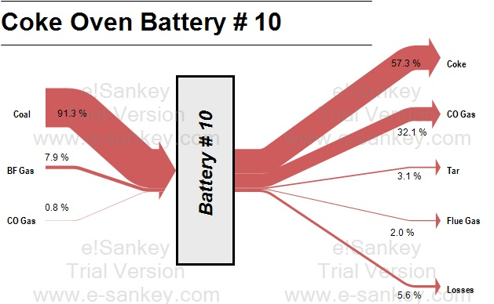
Battery # 10

Slide 8
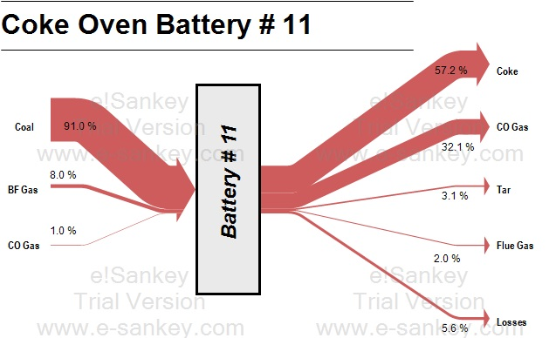
Battery # 11

